Slide 1
File systems
Secondary storage devices
Types of storage devices
Disk structure
Address mapping
Disk formatting
Boot time
Files
Directories
File system implementation
File system example: MS-DOS

Slide 2
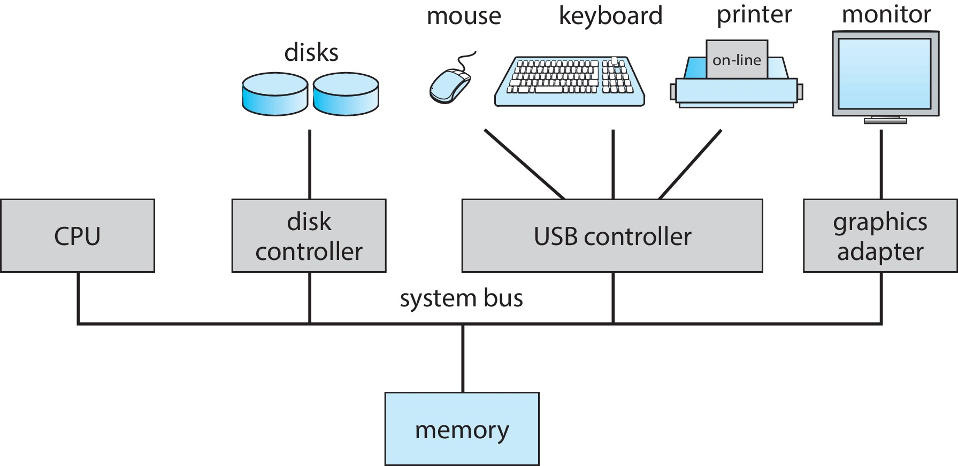
Computer System Hardware
Computer-system hardware
One or more CPUs, device controllers connect through common bus providing access to the memory and other I/O devices

Slide 3
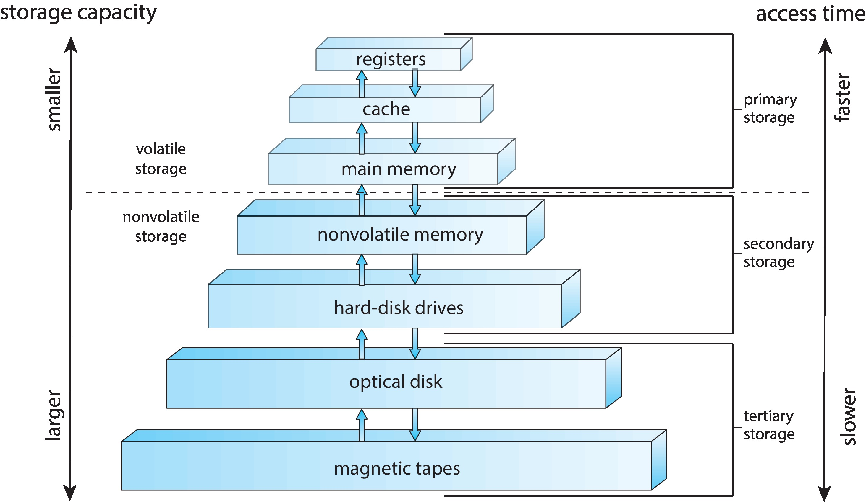
Storage-device hierarchy

Slide 4
File-system Management
OS abstracts physical properties to logical storage unit - file
File-System management
Files usually organized into directories
OS activities include
Creating and deleting files and directories
Primitives to manipulate files and directories
Mapping files onto secondary storage

Slide 5
Mass storage devices
Bulk of secondary storage for modern computers is hard disk drives (HDDs) and nonvolatile memory (NVM) devices, mainly solid-state disks (SSDs)

Slide 6
Hard disk drives
HDDs spin platters of magnetically-coated material under moving read-write heads
Drives rotate at 60 to 250 times per second
Transfer rate is rate at which data flow between drive and computer
Positioning time (random-access time) is time to move disk arm to desired cylinder (seek time) and time for desired sector to rotate under the disk head (rotational latency)
Head crash results from disk head making contact with the disk surface -- Not good!

Slide 7
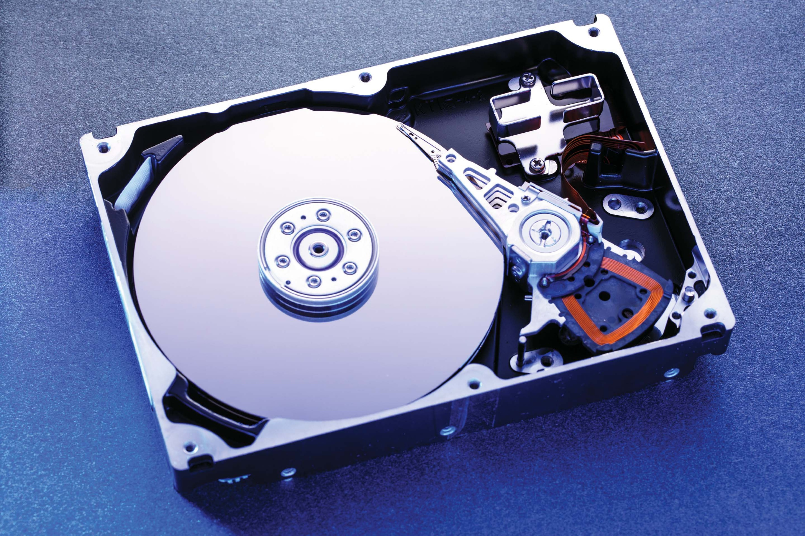
Hard Disk Drives
Platters range from .85” to 14” (historically)
Commonly 3.5”, 2.5”, and 1.8”
Range from 30GB to 3TB per drive
Performance
Transfer Rate – theoretical – 6 Gb/sec
Effective Transfer Rate – real – 1Gb/sec
Seek time from 3ms to 12ms – 9ms common for desktop drives
Average seek time measured or calculated based on 1/3 of tracks
Latency based on spindle speed
1 / (RPM / 60) = 60 / RPM
Average latency = ½ latency

Slide 8
Performance of HDDs
Read/write data is a three-stage process:
Seek time: position the head/arm over the proper track
Rotational latency: wait for desired sector to rotate under r/w head
Transfer time: transfer a block of bits (sector) under r/w head
Request Time = Queueing Time + Controller Time + Seek + Rotational + Transfer
Software
Queue
(Device Driver)
Hardware
Controller
Media Time
(Seek+Rot+Xfer)
Request
Result

Slide 9
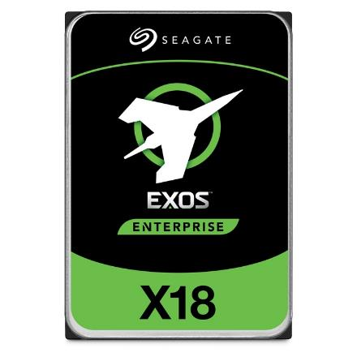
Example of Current HDDs
Seagate Exos X18 (2020)
18 TB hard disk
9 platters, 18 heads
Helium filled: reduce friction and power
4.16ms average seek time
4096 byte physical sectors
7200 RPMs
Dual 6 Gbps SATA /12Gbps SAS interface
270MB/s MAX transfer rate
Cache size: 256MB
Price: $ 562 (~ $0.03/GB)
IBM Personal Computer/AT (1986)
30 MB hard disk
30-40ms seek time
0.7-1 MB/s (est.)
Price: $500 ($17K/GB, 340,000x more expensive !!)

Slide 10
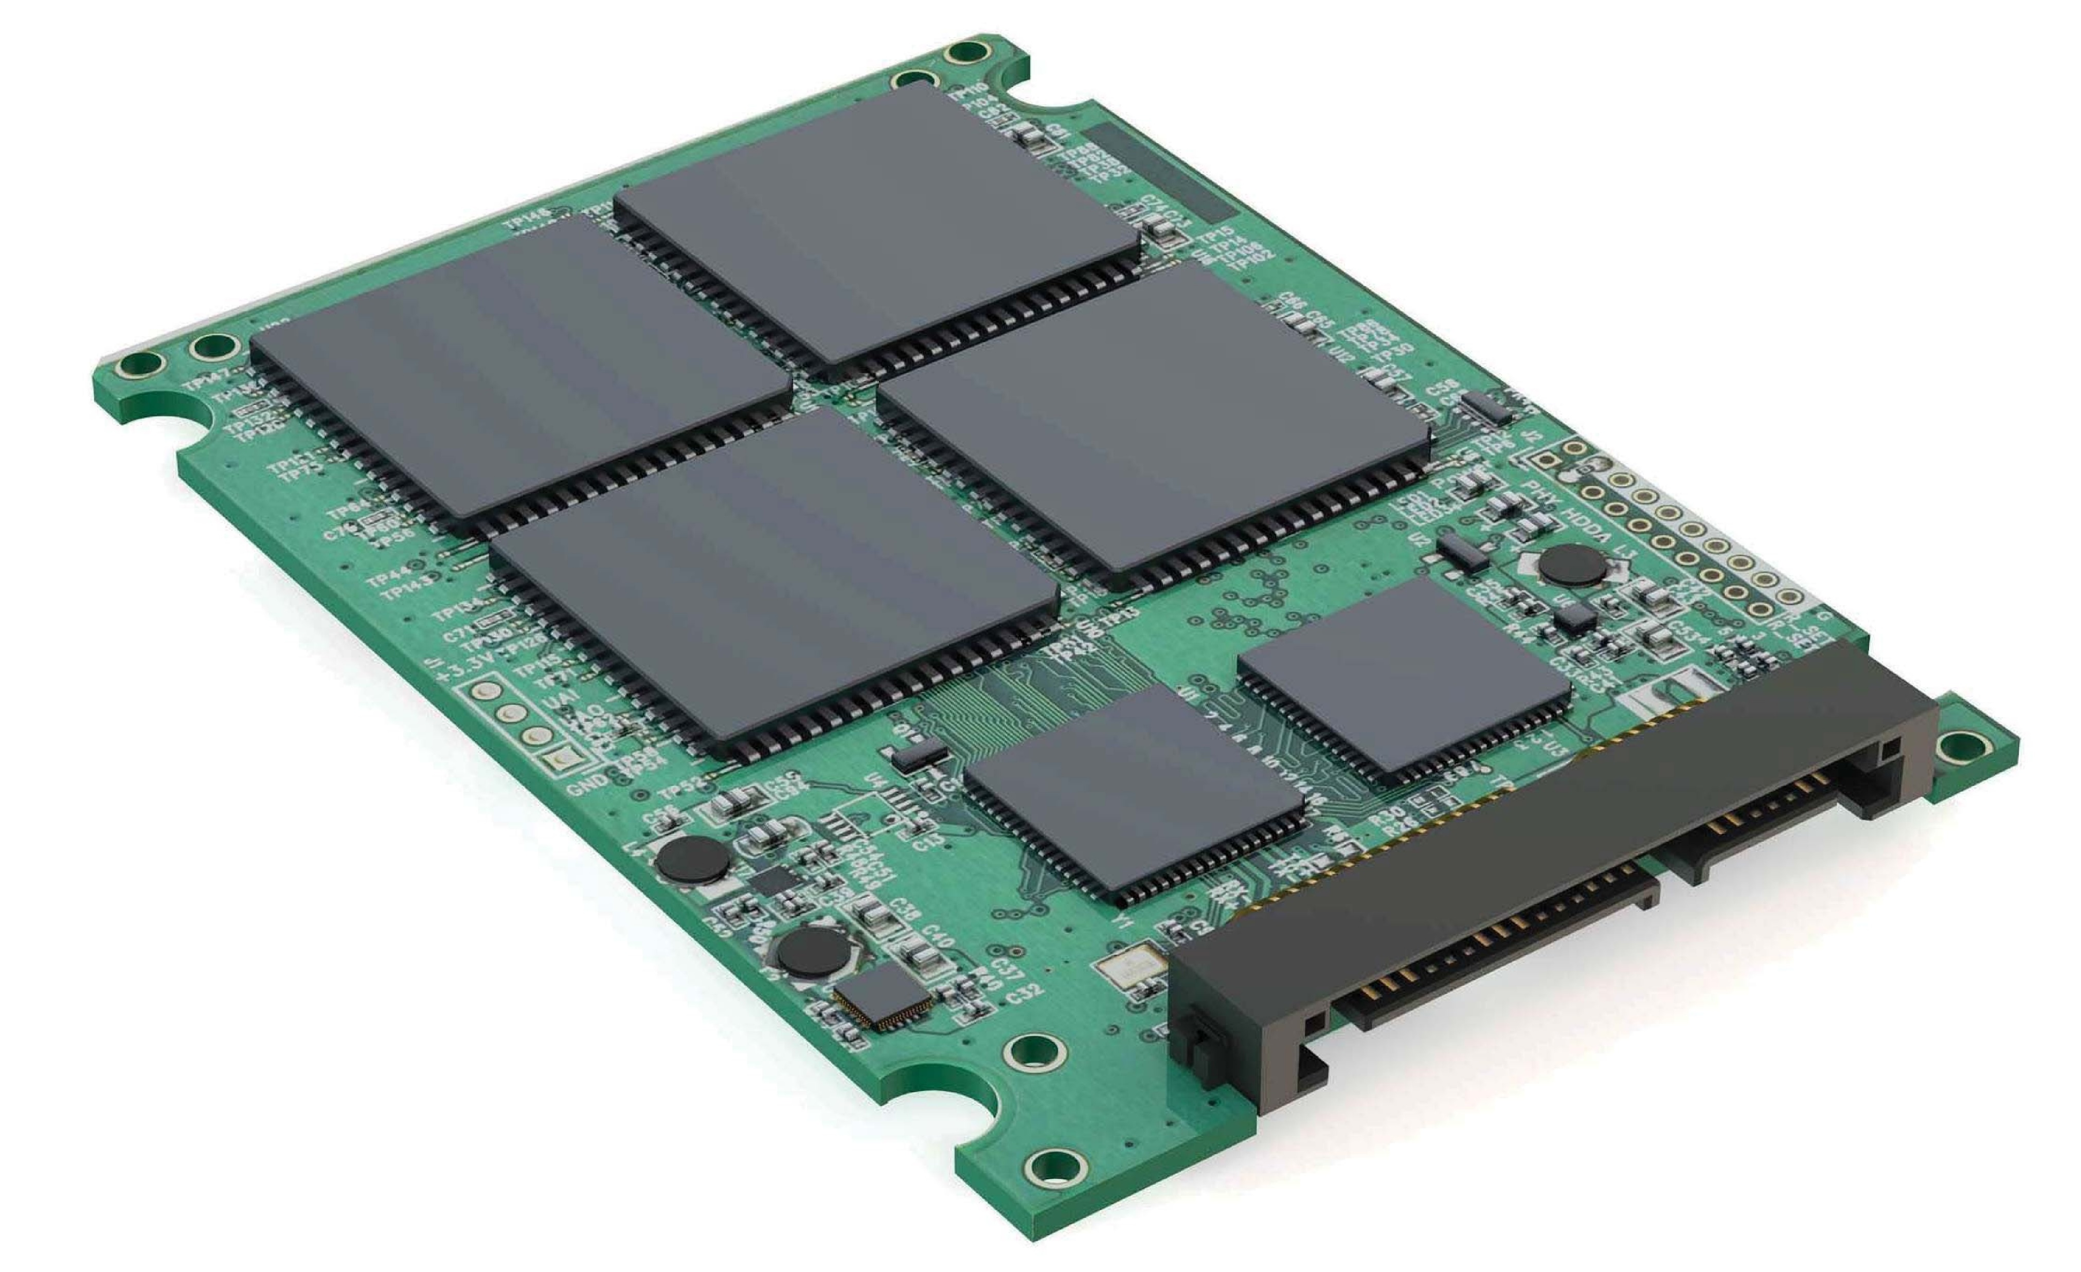
Nonvolatile memory (NVM) devices
If disk-drive like, then called solid-state disks (SSDs)
Other forms include USB drives
Can be more reliable than HDDs
More expensive per MB
Maybe have shorter life span – need careful management
Less capacity
But much faster
Busses can be too slow -> connect directly to PCI for example
No moving parts, so no seek time or rotational latency

Slide 11
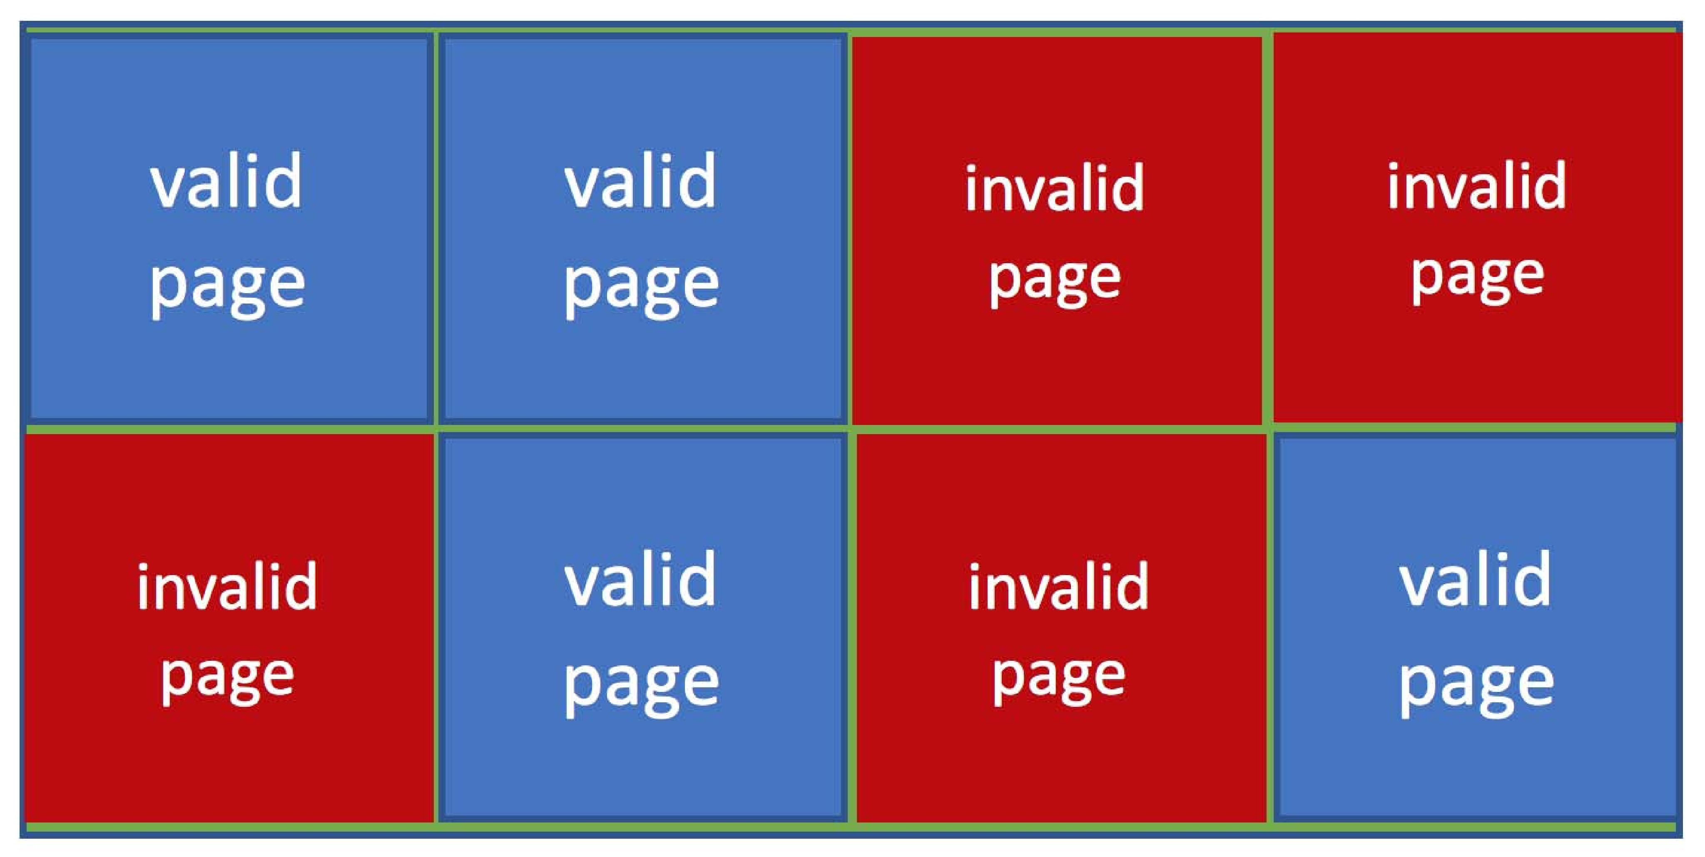
Nonvolatile Memory Devices
Based on NAND semiconductors technology, have some characteristics that present their own storage and reliability challenges
Read and written in “page” increments (think sector) but can’t overwrite in place
Must first be erased, and erases can only be executed in ”block” increments
Can only be erased a limited number of times before worn out – ~ 100,000
Life span measured in drive writes per day (DWPD)
A 1TB NAND drive with rating of 5DWPD is expected to have 5TB per day written within warrantee period without failing
With no overwrite, pages end up with mix of valid and invalid data
NAND block with valid and invalid pages

Slide 12
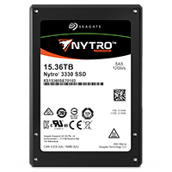
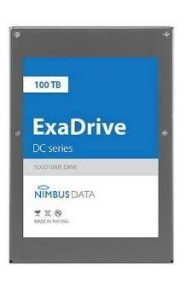
Some “Current” (large) 3.5in SSDs
Seagate Exos SSD: 15.36TB (2017)
Seq reads 860MB/s
Seq writes 920MB/s
Price (Amazon): $5495 ($0.36/GB)
Nimbus SSD: 100TB (2019)
Seq reads/writes: 500MB/s
Random Read Ops (IOPS): 100K
Unlimited writes for 5 years!
Price: ~ $40K? ($0.4/GB)
However, 50TB drive costs $12500 ($0.25/GB)

Slide 13
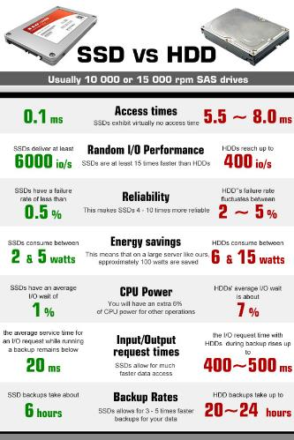
HDD vs. SSD Comparison
HDD | SDD
Require seek + rotation | No seeks
Not parallel (one head) | Parallel
Brittle (moving parts) | No moving parts
Random reads take 10s milliseconds | Random reads take 10s microseconds
Slow (Mechanical) | Wears out
Cheap/large storage | Expensive/smaller storage

Slide 14
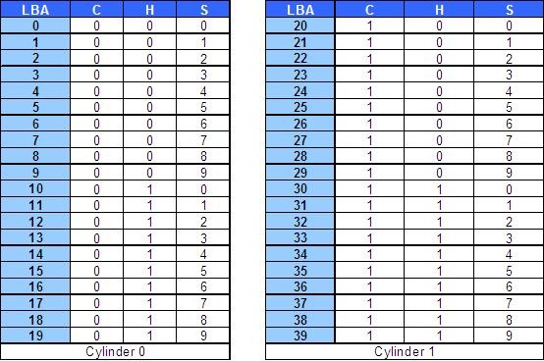
Address mapping
Disk drives are addressed as large 1-dimensional arrays of logical blocks, where the logical block is the smallest unit of transfer

Slide 15
Address mapping
The 1-dimensional array of logical blocks is mapped into the sectors of the disk sequentially
Blocks (LBA = Logical block addressing) are addressed by means of a tuple which defined the cylinder (track), head, and sector at which they appeared on the hard disk

Slide 16
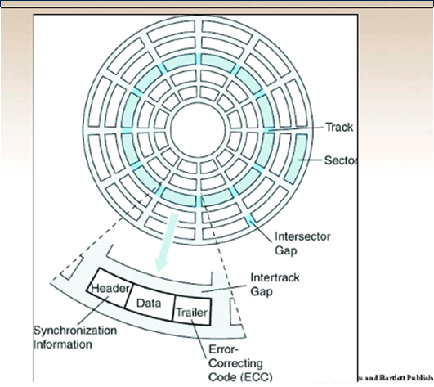
Disk formatting
A new storage device is a blank slate: it is just a platter of a magnetic recording material (HDD) or a set of uninitialized semiconductor storage cells (SSD)
Before a storage device can store data, it must be divided into sectors that the controller can read and write, this is called low-level formatting
Low-level formatting, or physical formatting — Dividing a disk into sectors that the disk controller can read and write
Each sector can hold header information, plus data, plus error correction code (ECC)
Usually 512 bytes or 4KB
Most drives are low-level-formatted at the factory as a part of the manufacturing process.

Slide 17
Disk formatting
The next step is disk partition.
Partition: the disk is partitioned into one or more groups of cylinders, each treated as a logical disk
For instance, one partition can hold a file system containing a copy of the operating system’s executable code, another the swap space, and another a file system containing the user files
The partition information is written in a fixed format at a fixed location on the storage device

Slide 18
Disk formatting
The last step is logical formatting or creation of a file system
In this step, the operating system stores the initial file-system data structures:
Superblock. Contains a magic number to identify the file-system type, the number of blocks in the file system, and other key administrative information
free blocks in the file system in the form of a bitmap or a list of pointers
i-nodes
Root directory of the file system

Slide 19
Boot time
Each partitions can have a different file system.
Sector 0 of the disk is called the MBR (Master Boot Record) and is used to boot the computer.
The end of the MBR contains the partition table. This table gives the starting and ending addresses of each partition.

Slide 20
Boot time
One of the partitions in the table is marked as active. When the computer is booted, the BIOS reads in and executes the MBR.
The first thing the MBR program does is locate the active partition, read in its first block, which is called the boot block, and execute it.
The program in the boot block loads the operating system contained in that partition
Every partition starts with a boot block, even if it does not contain a bootable operating system.

Slide 21
Files
Files are logical units of information created by processes.
When a process creates a file, it gives the file a name.
When the process terminates, the file continues to exist and can be accessed by other processes using its name.
So, files provide a way to store information on the disk and read it back later.

Slide 22
File naming
The exact rules for file naming vary from system to system, but all current operating systems allow strings of one to eight letters as legal file names.
andrea, bruce, and cathy are possible file names.
Digits and special characters are also permitted, like 2, urgent!, and Fig.2-14
Many file systems support names as long as 255 characters.
Some file systems distinguish between upper- and lowercase letters (UNIX), whereas others do not (MS-DOS)

Slide 23
File naming
Many operating systems support two-part file names, with the two parts separated by a period, as in prog.c.
The part following the period is called the file extension and usually indicates something about the file.
In MS-DOS, for example, file names are 1 to 8 characters, plus an optional extension of 1 to 3 characters.
In UNIX, the size of the extension, if any, is up to the user, and a file may even have two or more extensions: homepage.html.zip
UNIX file extensions are just conventions and are not enforced by the operating system
Windows is aware of the extensions and assigns meaning to them. When a user double clicks on a file name, the program assigned to its file extension is launched with the file as parameter.
For example, double clicking on file.docx starts Microsoft Word with file.docx as the initial file to edit.

Slide 24
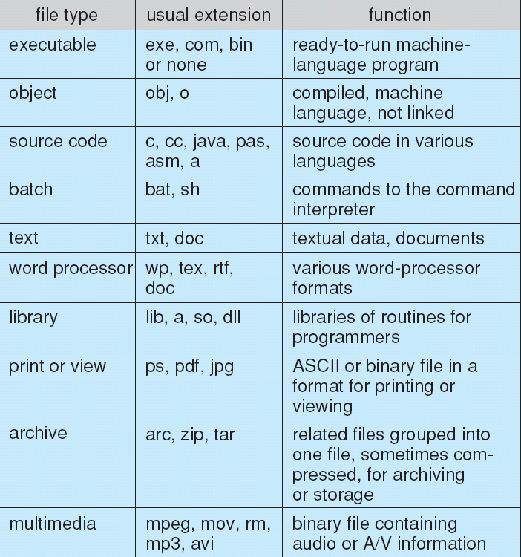
File types, extensions
.
Tanenbaum, Modern Operating Systems 3 e, (c) 2008 Prentice-Hall, Inc. All rights reserved. 0-13-6006639

Slide 25
File Structure
None - sequence of bytes
Simple record structure
Lines (directories)
Fixed length
Variable length
Complex Structures
Formatted document (Word, Latex, binaries)
Relocatable load file (libraries)
Who decides:
Operating system
Program

Slide 26
File types
Regular- contains user information (ASCII, binary)
Directories, are system files for maintaining the structure of the file system

Slide 27
File access
Sequential Access
read next
write next
reset
no read after last write
(rewrite)
Direct Access – file is fixed length logical records
read n
write n
position to n
read next
write next
rewrite n
n = relative block number
Tanenbaum, Modern Operating Systems 3 e, (c) 2008 Prentice-Hall, Inc. All rights reserved. 0-13-6006639

Slide 28
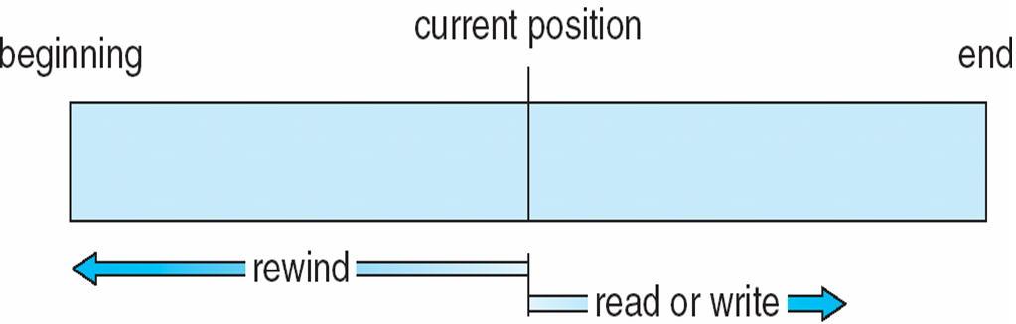
Sequential access file

Slide 29
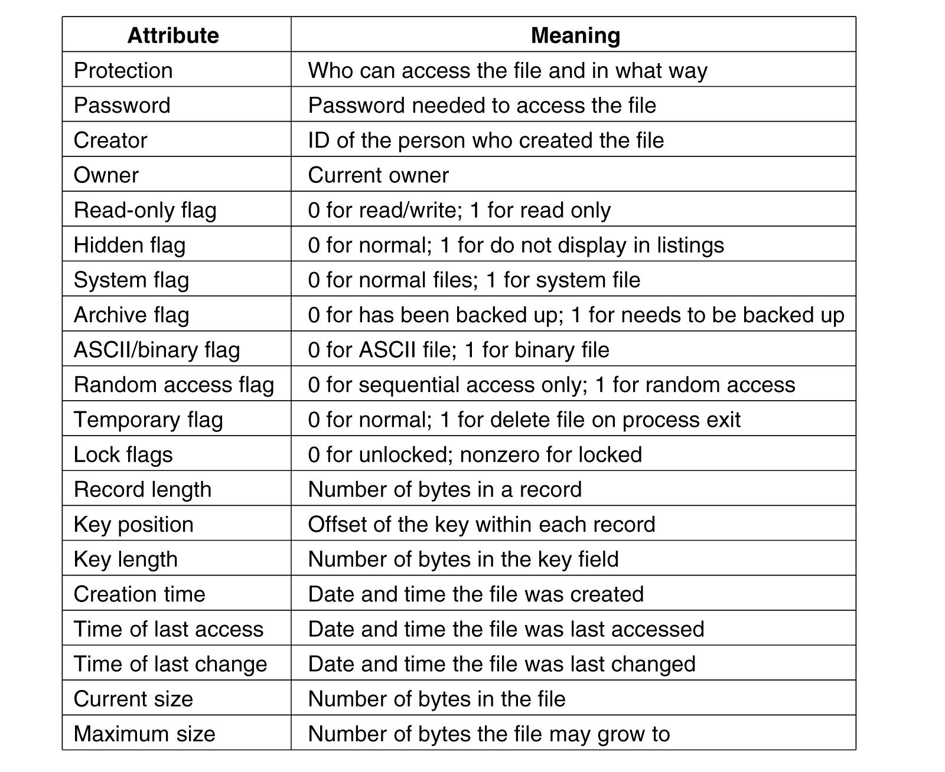
File attributes
Every file has a name and its data.
In addition, all operating systems associate other information with each file, the date and time the file was last modified and the file’s size.
These extra items the file’s attributes or metadata.
The list of attributes varies considerably from system to system

Slide 30
System calls for files
Create. The file is created with no data. It set some of the attributes.
Delete. When the file is no longer needed, deleted to free up disk space.
Open. Fetch attributes and disk addresses into main memory for rapid access
Close. Free up internal table space used by attributes and addresses
Read.
Write.
Append. Add data only to the end of the file..
Seek. Repositions the file pointer to a specific place in the file. After this call has completed, data can be read from, or written to, that position.

Slide 31
Open Files
Several pieces of data are needed to manage open files:
Open-file table: tracks open files
File pointer: pointer to last read/write location, per process that has the file open
File-open count: counter of number of times a file is open – to allow removal of data from open-file table when last processes closes it
Disk location of the file: cache of data access information
Access rights: per-process access mode information

Slide 32
Copyfile abc xyz
. . .

Slide 33
Copyfile abc xyz
.

Slide 34
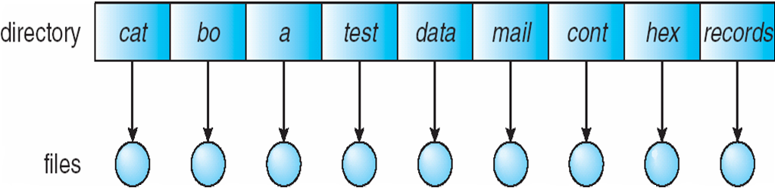
Directories
To keep track of files, file systems normally have directories, which are themselves files.
A directory is a file with a special structure
Two types of directories: Single-Level Directory and Hierarchical directory
Single-Level Directory Systems: one directory containing all the files
Was common in early personal computers

Slide 35
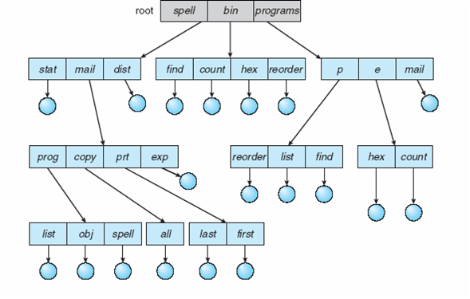
Hierarchical directory systems
It is a tree where leaves are data-files and internal nodes are directory-files
Each directory-file contains a mix of data-files and subdirectories
The tree has, as a root node which is a directory, the root directory

Slide 36
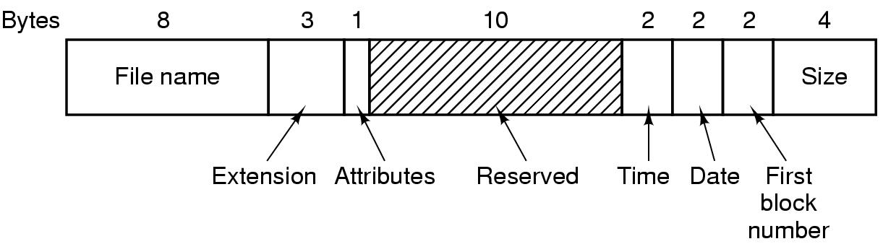
MS-DOS directory entry
MS-DOS directories have variable length, but each entry is 32 bytes long
The Attributes field contains bits to indicate that a file is read-only, needs to be archived, is hidden, or is a system file.
For Linux, a directory entry is a string of characters (file name) and a number (i-node), ls -i

Slide 37
Path names
When the file system is based on a directory tree, a file is identified using its name and a path in the tree.
Two different methods:
Absolute path name consisting of the path from the root directory to the file. As an example, the path /usr/ast/mailbox
Relative path name. In conjunction with working directory (also called the current directory). Path names beginning with the working directory

Slide 38
System calls for directories
Create. Empty except for dot and dotdot (mkdir in Linux)
Delete. Only an empty directory can be deleted (same as deleting a file, in Linux “rm –option directory”)
Opendir. Directories can be read. For example, to list all the files
Closedir. When a directory has been read, it should be closed to free up internal table space.
Readdir. This call returns the next entry in an open directory.
Rename. Directories are just like files and can be renamed the same way files can be.

Slide 39
File system implementation
The file system is stored on a disk
Superblock: contains all the key parameters about the file system, it is read into memory when the computer is booted or the file system is first touched.
Typical information in the superblock includes a magic number to identify the file-system type, the number of blocks in the file system, and other administrative information.

Slide 40
File system implementation
Next might come information about free blocks in the file system, for example in the form of a bitmap or a list of pointers.
This might be followed by the i-nodes, an array of data structures, one per file, telling all about the file.
After that might come the root directory, which contains the top of the file-system tree.
Finally, the remainder of the disk contains all the other directories and files.

Slide 41
Storing files
Files are stored in blocks (sectors) of the disk, so there must be a policy to allocate blocks to files (similar to allocate main memory to processes)
Allocation methods:
Contiguous blocks
Linked list of blocks
Linked list using table
I-nodes

Slide 42
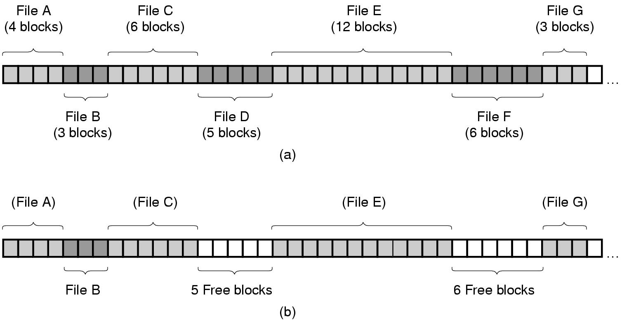
Contiguous allocation
The simplest allocation scheme is to store each file as a contiguous run of disk blocks.
Thus on a disk with 1-KB blocks, a 50-KB file would be allocated 50 consecutive blocks
The directory entry only need the address of the first block
Drawback: over time, the disk becomes fragmented.

Slide 43
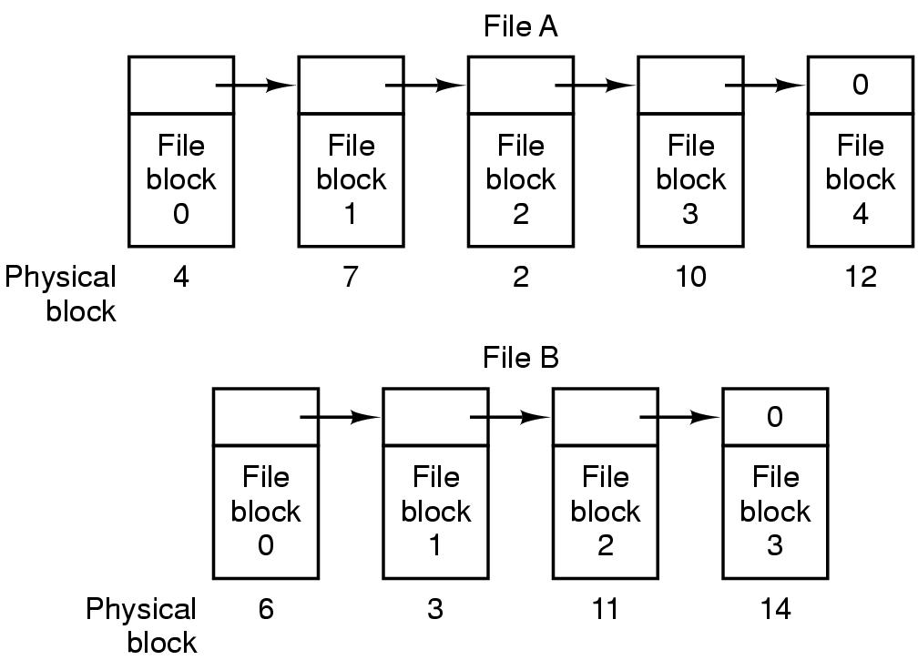
Linked list allocation
Here each is stored as a linked list of disk blocks.
The first word of each block is used as a pointer to the next one.
The rest of the block is for data.
The directory entry only need the address of the first block
Random access is slow, need to chase all the pointers

Slide 44
Linked list allocation using table
Have a table in main memory of the same size as the number of blocks on the disk
Store the address of the next block in the tale
Inconvenient: Table too big, with a 1-TB disk and a 1-KB block size, the table needs 1 billion entries, one for each of the 1 billion disk blocks
This “file allocation table” (FAT) come in different forms in MS_DOS and Windows, FAT-12, FAT-16, FAT-32

Slide 45
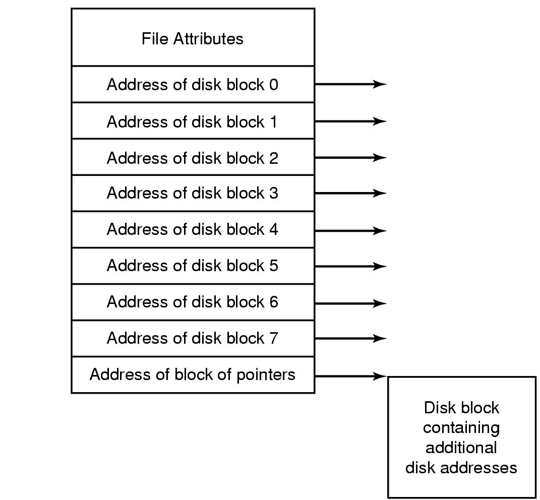
I-nodes
Lists the attributes and disk addresses of the file’s blocks
There is one i-node per file, i-nodes are stored on a specific set of blocks on the disk, when a file is opened, they are loaded in main memory
i-nodes contain a fix number of disk addresses, if file is big, one address is kept to store the address of a block that contain more disk address
i-nodes is the method in Unix/Linux operating systems, Windows has a similar system called NTFS

Slide 46
Implementing directories
Before a file can be read, it must be opened.
When a file is opened, the operating system uses the path name supplied by the user to locate the directory entry on the disk.
Then the directory is loaded in main memory where it can be read.
The directory entry provides the information needed to find the disk blocks of the file.
Depending on the system this information may be:
the disk address of the entire file (with contiguous allocation),
the number of the first block (both linked- list schemes),
or the number of an i-node.
In all cases, the main function of the directory system is to map the ASCII name of the file onto the information needed to locate the data.

Slide 47
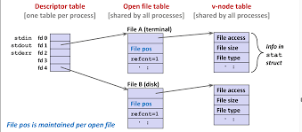
File descriptor (fd)
File descriptors index into a per-process file descriptor table, which indexes into a system-wide table of files opened by all processes, called the file table.
The file table records the mode with which a file has been opened: reading, writing, appending and indexes into a third table called inode table (v-node)
When a file is opened, the path name must be used to the file on disk. After that the read or write operations only need the fd to find the file.
Linux file descriptors of a process can be accessed in /proc/PID/fd/

Slide 48
Opening a file
The open() system call passes a file name to the file system.
The open() system call first searches the open-file table to see if the file is already in use by another process.
If it is, an entry is created into the process file descriptor table pointing to the existing open-file table.
If the file is not already open, the directory structure is searched for the given file name.
Once the file is found, its i-node is copied in main memory and an entry in the open-file table is created pointing to the new i-node
Next, an entry is made in the process file descriptor, with a pointer to the newly created entry in the open-file table
The open() call returns a pointer to the appropriate entry in the file descriptor of the process.
All other file operations (read, write, ect.) are then performed via this pointer.

Slide 49
Opening a file: example
Open(/usr/me/mailbox), not already open
1-find entry of “usr” in / and get the i-node of usr on disk
2-load i-node in main memory
3-find blocks of the directory file usr on disk
4-load the directory usr in main memory
5-read usr until find entry of directory “me” and read the number of the corresponding i-node
6-find i-node of “me” on disk and load it in main memory
7-read the directory “me” until string “mailbox” is found
8-read the i-node number of file “mailbox”
9-find the i-node on disk and load it in main memory
10-create an entry in the open file table and makes it point to the i-node for the mailbox file
11-create an entry in the file descriptor table and makes it point to the corresponding entry in the open file table
12 returns the entry number to the calling process
The system usually don’t need the absolute path, rather the relative path from the current working directory is enough

Slide 50
Implementing directories
Another issue is where the attributes should be stored.
Every file system maintains various file attributes, such as each file’s owner and creation time, and they must be stored somewhere.
One obvious possibility is to store them directly in the directory entry.
For systems that use i-nodes, another possibility for storing the attributes is in the i-nodes, rather than in the directory entries

Slide 51
Multiple file systems
A computer or an operating system could use different file systems
Windows may have a main NTFS file system, but also a legacy FAT -32 or FAT -16 drive or partition that contains old, but still needed, data, and from time to time a flash drive, an old CD-ROM or a DVD
Windows handles these disparate file systems by identifying each one with a different drive letter, as in C:, D:, etc.
When a process opens a file, the drive letter is explicitly or implicitly present so Windows knows which file system to pass the request to.
Windows does not have a virtual file system

Slide 52
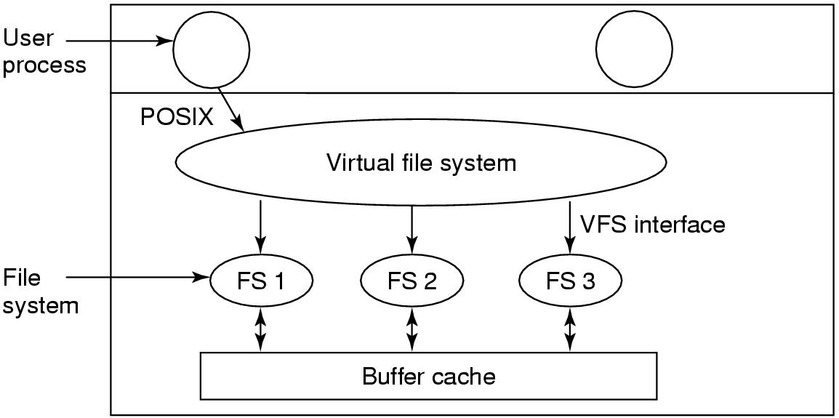
Virtual file systems
UNIX systems integrate multiple file systems into a single VFS structure.
For example, a Linux system could have ext2 as the root file system, with an ext3 partition mounted on /usr and a second hard disk with a ReiserFS file system mounted on /home as well as an ISO 9660 CD-ROM temporarily mounted on /mnt.
POSIX system calls such as open, read, write, lseek, are directed to the virtual file system for initial processing

Slide 53
Virtual file systems
The VFS also has also a ‘‘lower’’ interface to the concrete file systems
This interface consists of several dozen function calls that the VFS can make to each file system to get work done.
To create a new file system that works with the VFS, the designers of the new file system must make sure that it supplies the function calls the VFS requires.

Slide 54
Virtual file systems
Most file systems under the VFS are partitions on the local disk.
They can also be a remote file systems using the NFS (Network File System) protocol.

Slide 55
How VFS works
When the system is booted, the root file system is registered with the VFS.
When other file systems are mounted, either at boot time or during operation, they, too must register with the VFS.
A file system registers by providing a list of the addresses of the functions the VFS requires, either as one long call vector (table) or as several of them, one per VFS object, as the VFS demands.

Slide 56
How VFS works
After a file system has been mounted, it can be used. For example, if a file system has been mounted on /usr and a process makes the call
open("/usr/include/unistd.h", O RDONLY)
Parsing the path, the VFS sees that a new file system has been mounted on /usr and locates its superblock by searching the list of superblocks of mounted file systems.
The VFS find the root directory of the mounted file system and look up the path include/unistd.h there.

Slide 57
How VFS works
The VFS then creates a v-node and makes a call to the concrete file system to return all the information in the file’s inode.
This information is copied into the v-node (in RAM), along with other information, most importantly the pointer to the table of functions to call for operations on v-nodes, such as read, write, close, and so on.
After the v-node has been created, the VFS makes an entry in the file-descriptor table for the calling process and sets it to point to the new v-node

Slide 58
How VFS works
Later when the process does a read using the file descriptor, the VFS locates the v-node from the process and file descriptor tables and follows the pointer to the table of functions, all of which are addresses within the concrete file system on which the requested file resides

Slide 59
Keeping track of free blocks
Two methods.
One: use a linked list of disk blocks, with each block holding as many free disk block numbers as will fit:
With a 1-KB block and a 32-bit disk block number, each block on the free list holds the numbers of 255 free blocks. (One slot is required for the pointer to the next block.)
A 1-TB disk requires about 4 million blocks.

Slide 60
Keeping track of free blocks
Two methods.
Two: bitmap. A disk with n blocks requires a bitmap with n bits. Free blocks are represented by 1s in the map, allocated blocks by 0s
1-TB disk, we need 1 billion bits for the map, which requires around 130,000 1-KB blocks to store

Slide 61
Examples of FS: MS-DOS
To read a file, an MS-DOS program must first make an open system call to get a handle for it.
The open system call specifies a path
The path is looked up component by component until the final directory is located and read into memory. It is then searched for the file to be opened.
MS-DOS directories have variable length, but each entry is 32 bytes long
The Attributes field contains bits to indicate that a file is read-only, needs to be archived, is hidden, or is a system file.

Slide 62
Examples of FS: MS-DOS
MS-DOS stores the file size as a 32-bit number, so in theory files can be as large as 4 GB. However, other limits restrict the maximum file size to 2 GB or less.
MS-DOS keeps track of file blocks via a file allocation table in main memory.
The directory entry contains the number of the first file block. This number is used as an index into a 64K entry FAT (file allocation table) in main memory. By following the chain, all the blocks can be found.
The FAT file system comes in three versions: FAT -12, FAT -16, and FAT -32, depending on how many bits a disk address contains

Slide 63
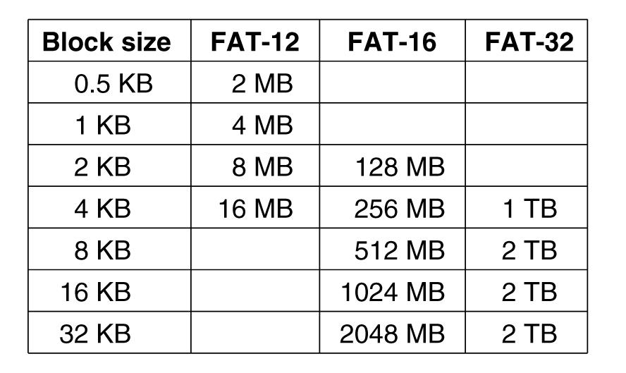
Examples of FS: MS-DOS
For all FATs, the disk block can be set to some multiple of 512 bytes
With blocks of 512 bytes and block address size 12 bits, a partition cannot be larger than 2MB.
The size of the FAT table in memory is 4096 entries of 2 bytes
MS-DOS supported four disk partitions per disk drive, so when disks with larger capacity came, blocks were made bigger

